Slide 1
Placement Management System

Slide 2

OBJECTIVE
To create Placement Management System that provides the facility of maintaining the details of students, placement and college.
Also, help in fast access procedures in placement related activity.

Slide 3
ABSTRACT
The Project is aimed at developing an application for the "Web Based Placement Management System" for the college. This application can be accessed and effectively used throughout the organization with proper login credentials.
In this application the Placement officers in the college is to manage the student information with regard to placement.
Our project provides the facility of maintaining the details of the students. It reduces the manual work and consumes less paper work to reduce the time.

Slide 4

ROAD MAP
Application is developed
Front End : HTML, CSS, Javascripts
Back End : JAVA, JSP, SERVLETS, JDBC, MYSQL

Slide 5




MODULES
Student
Placement
College
Certificate

Slide 6
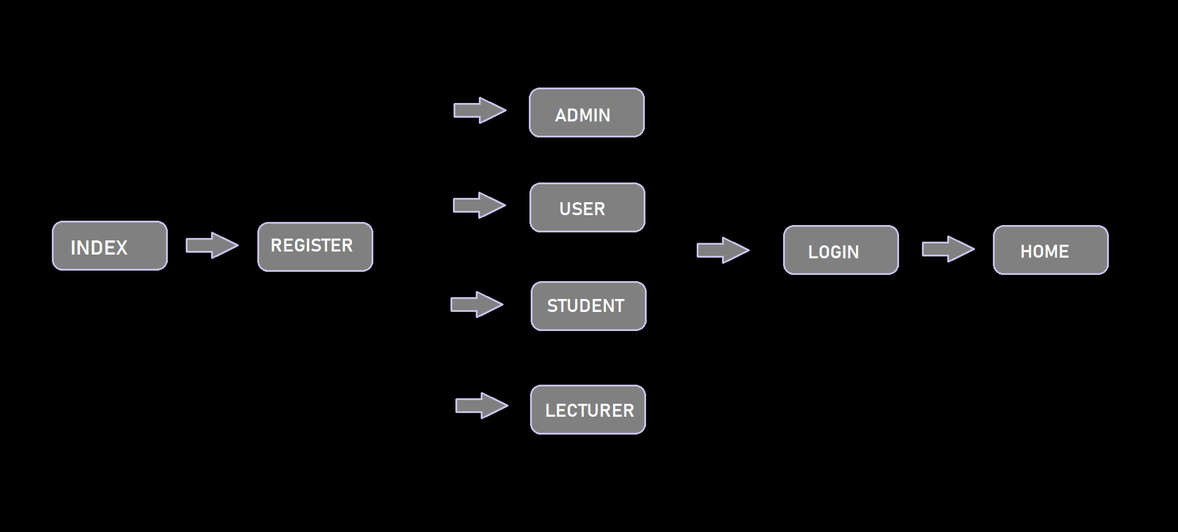
EVENT FLOW

Slide 7
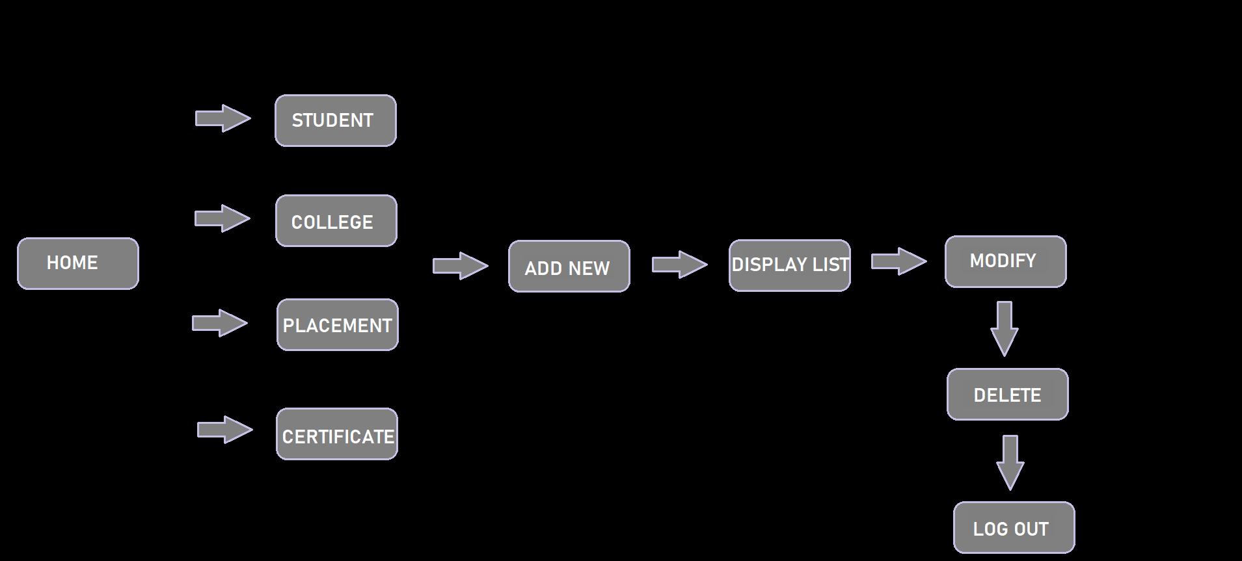

Slide 8
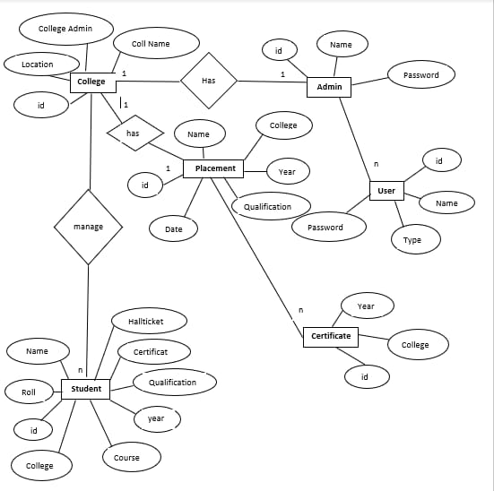
ER Diagram

Slide 9
SNAPSHOTS

Slide 10
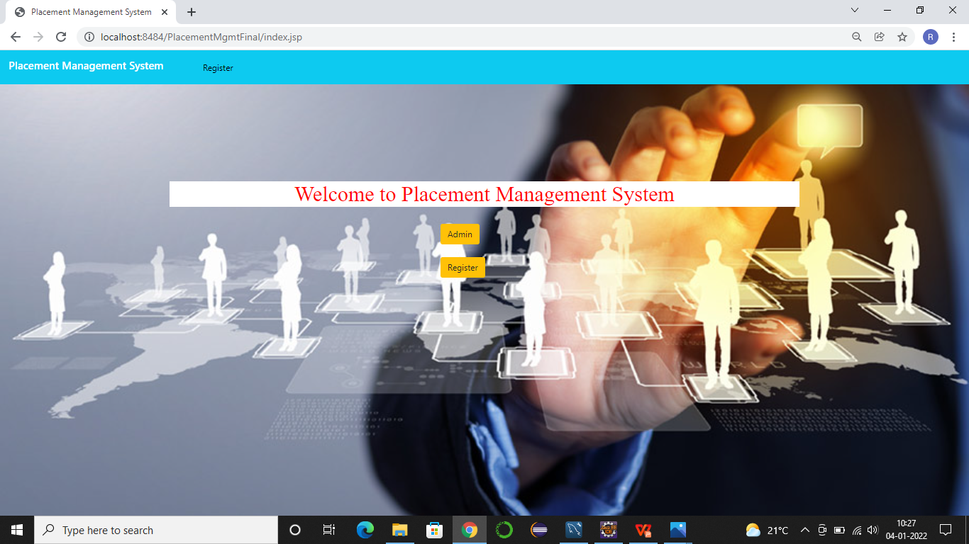

Slide 11
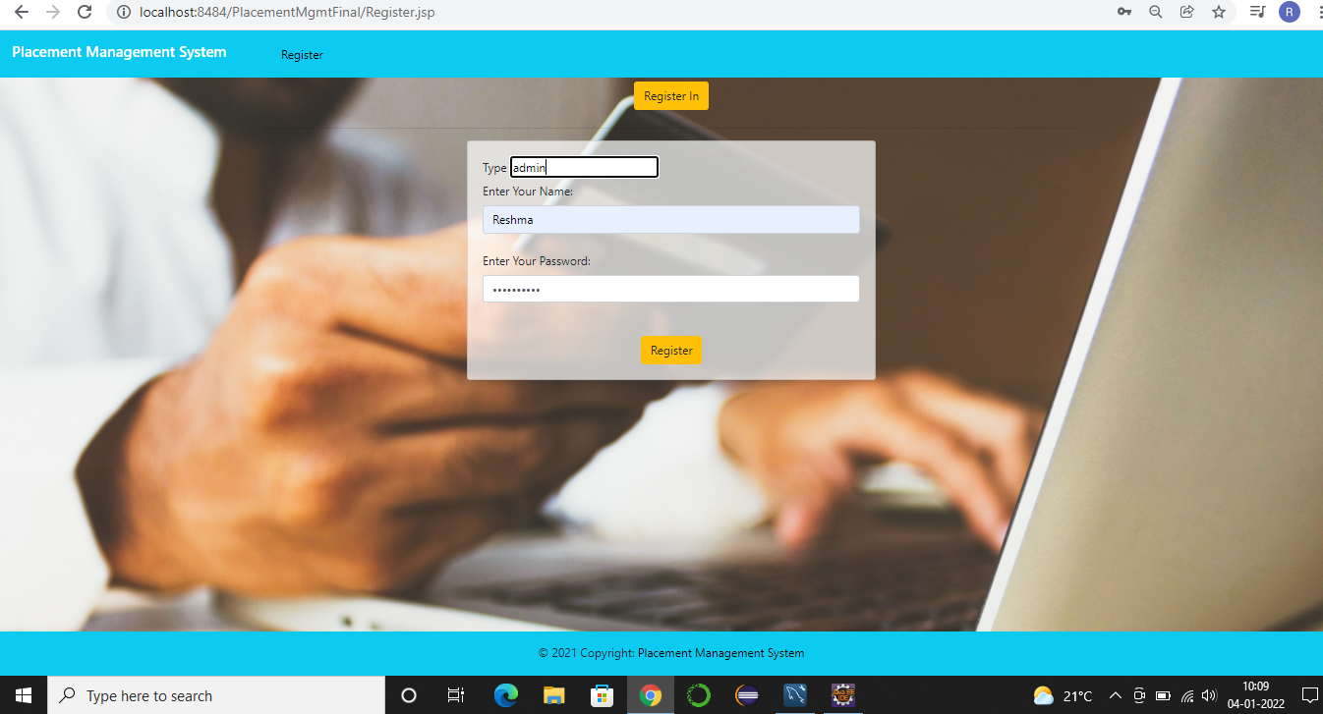

Slide 12
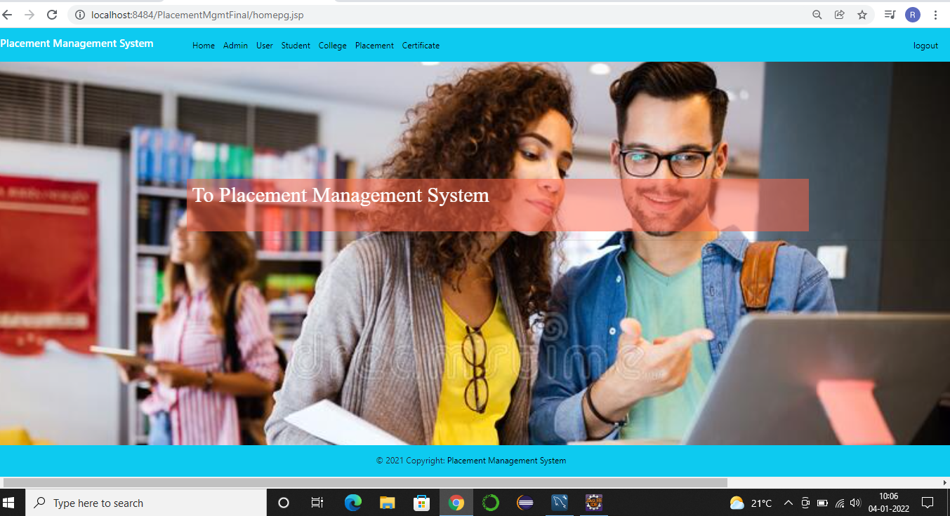

Slide 13
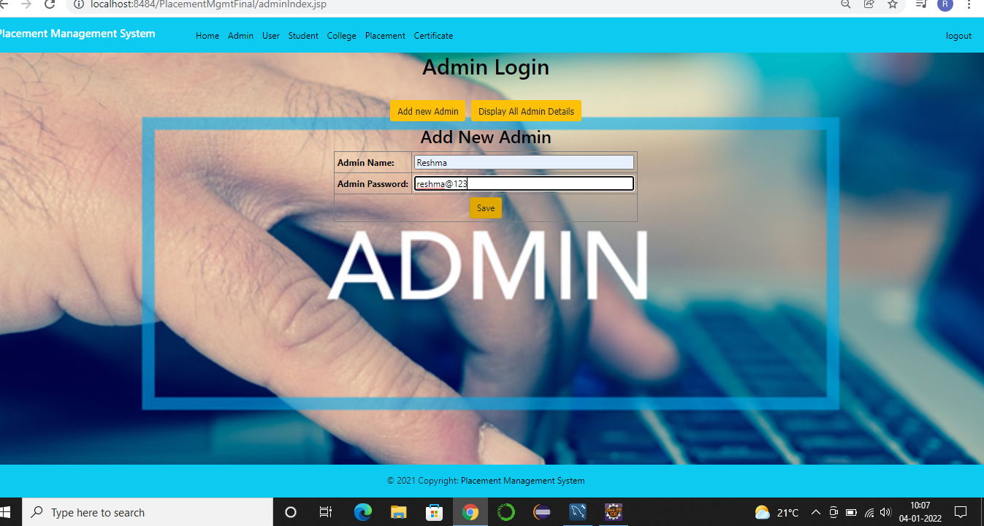

Slide 14
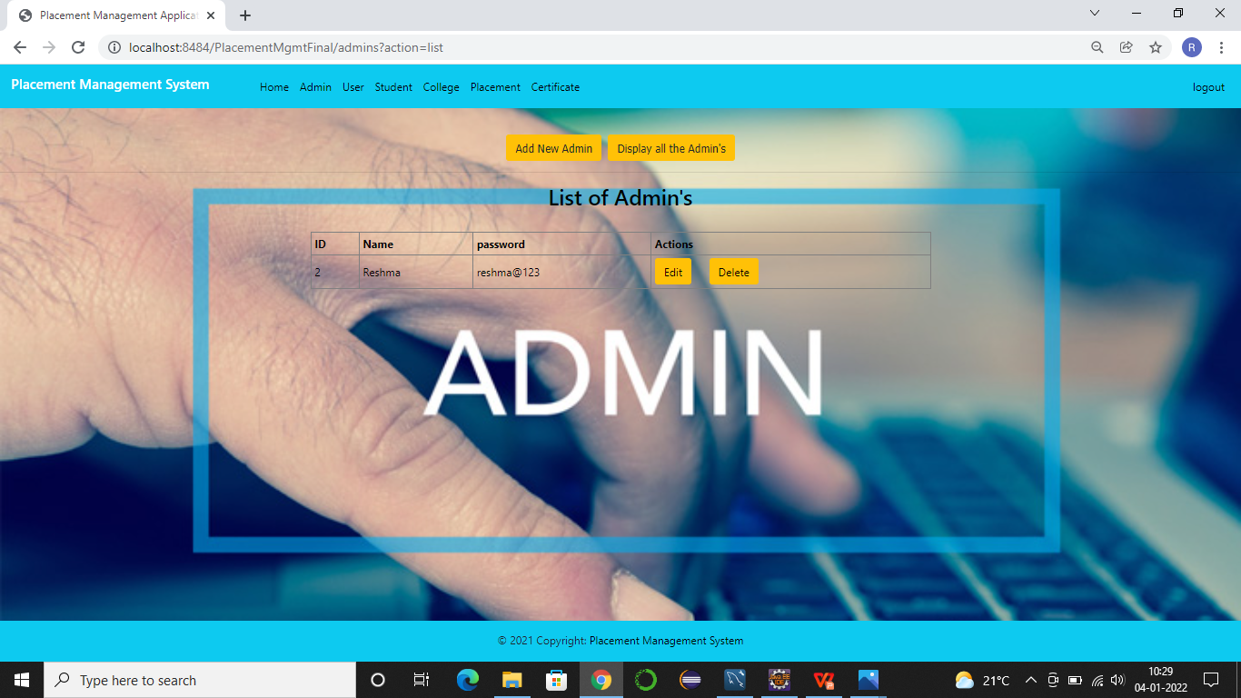

Slide 15
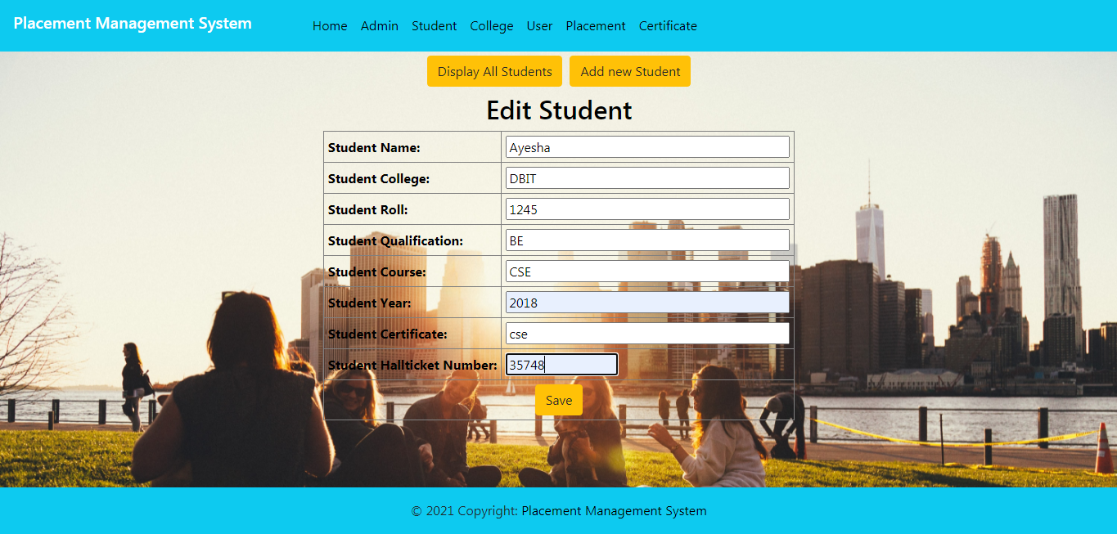

Slide 16
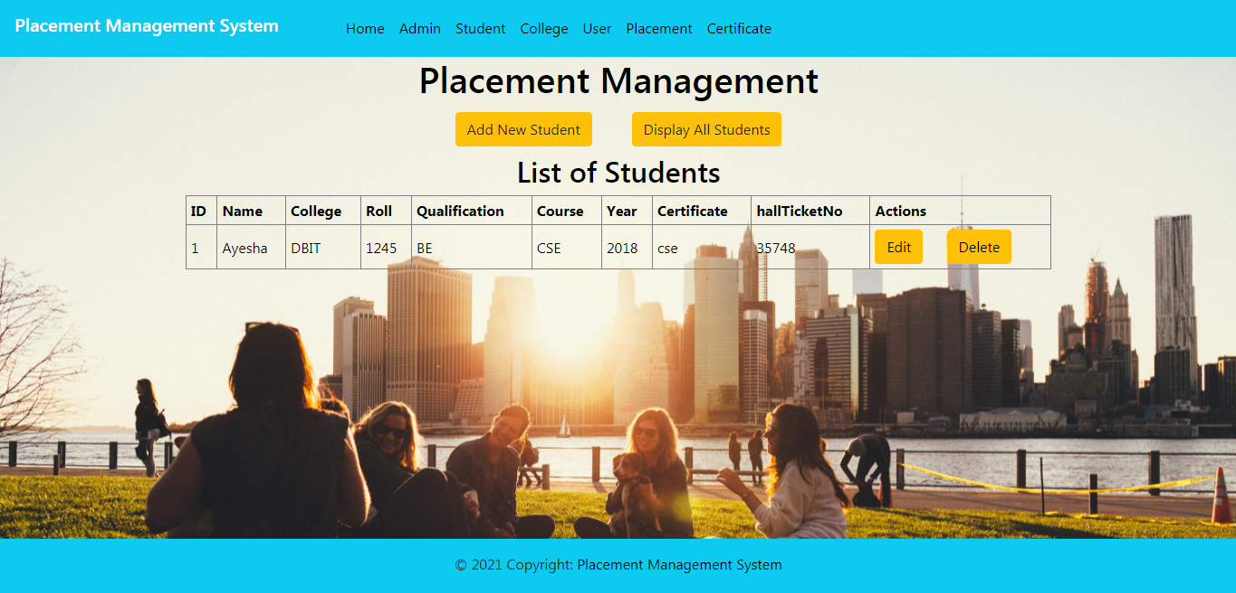

Slide 17
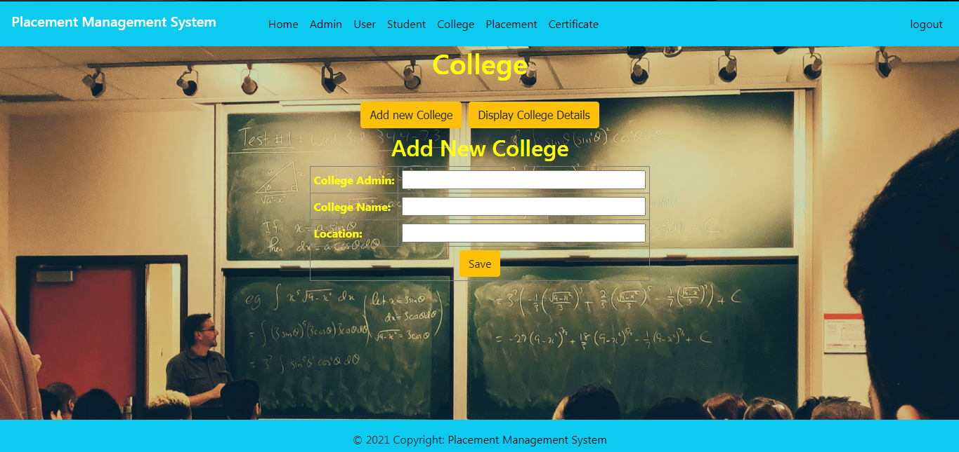

Slide 18
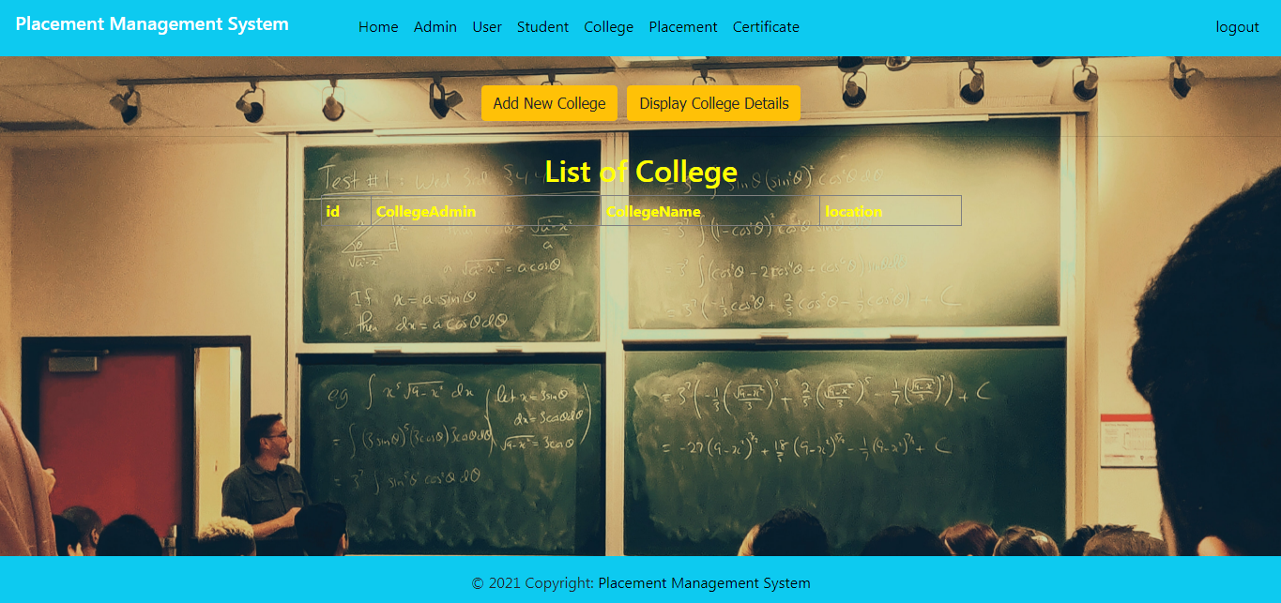

Slide 19
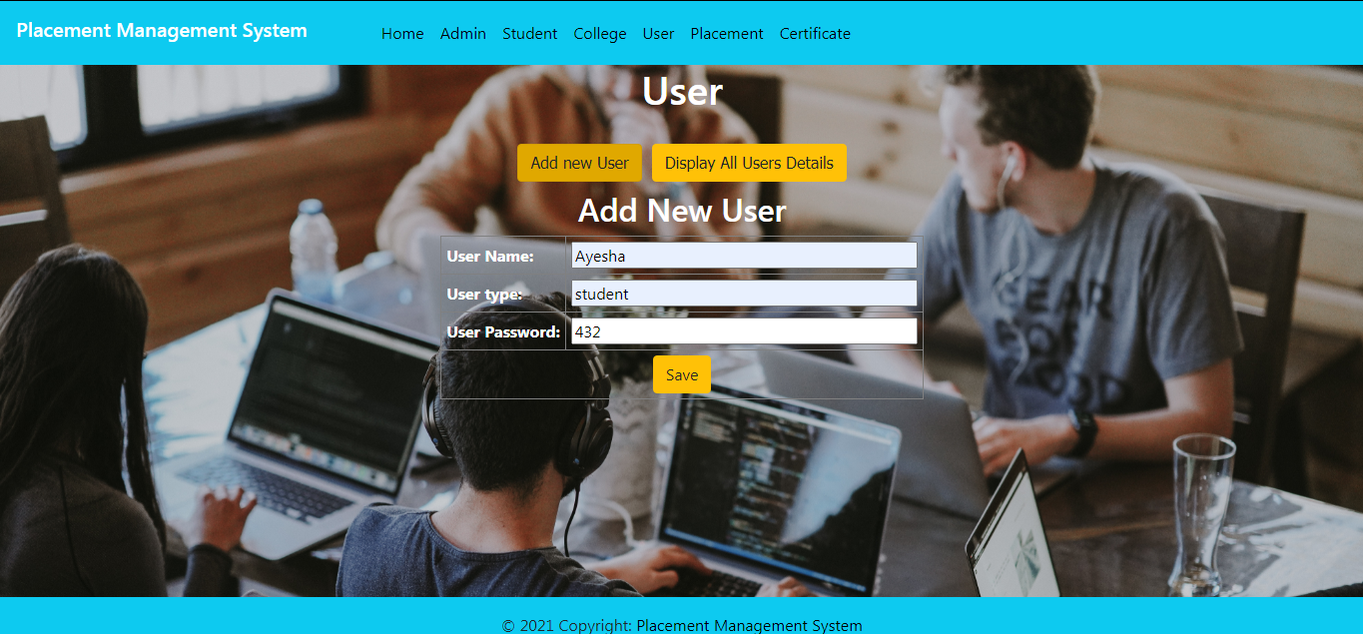

Slide 20
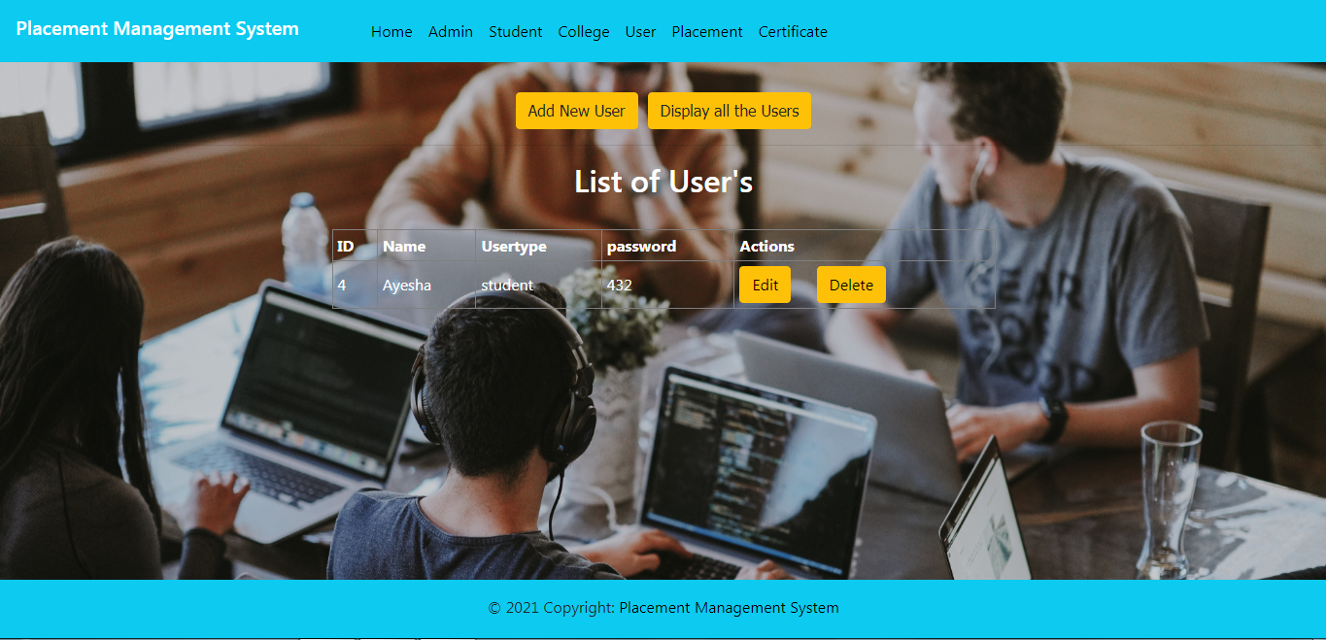

Slide 21
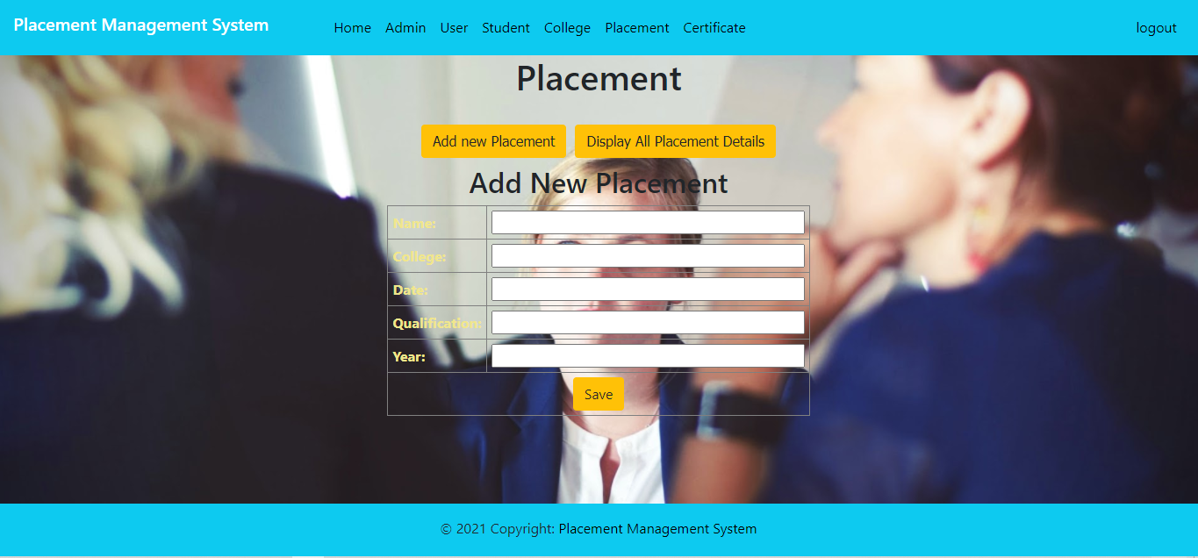

Slide 22
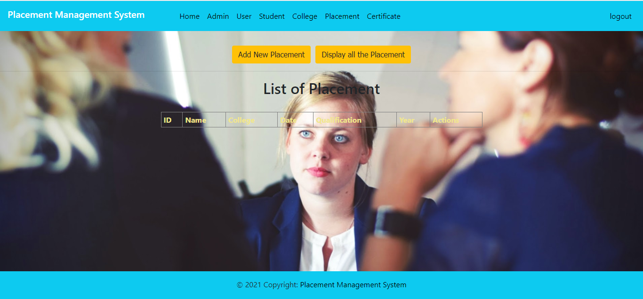

Slide 23
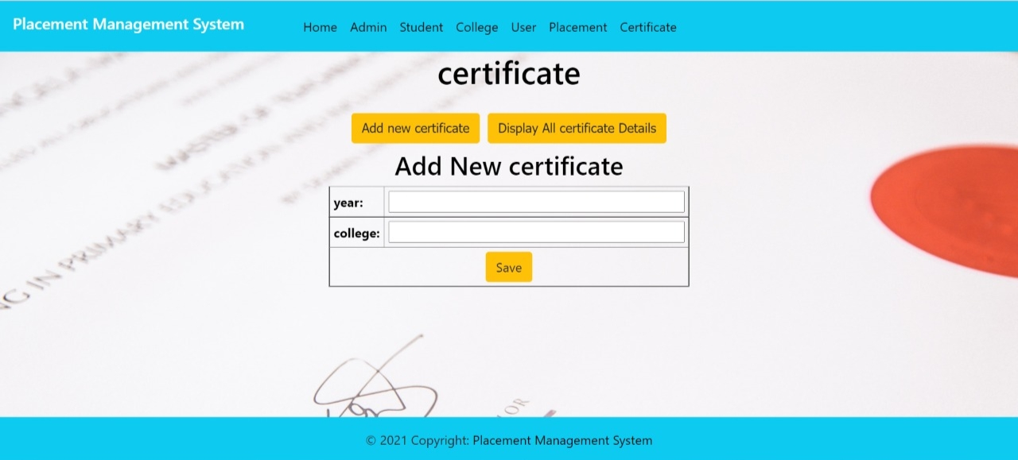

Slide 24
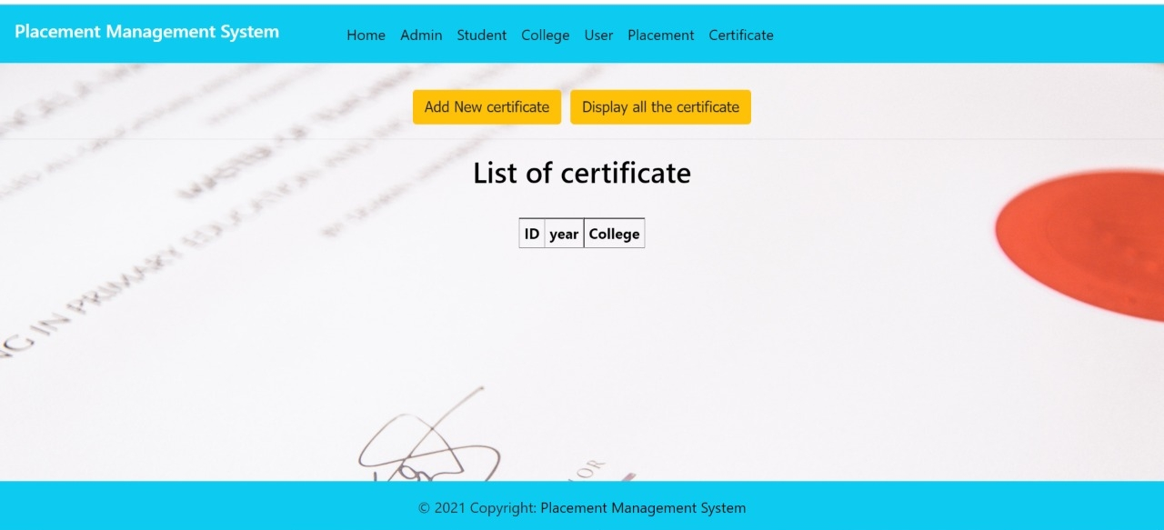

Slide 25


